Slide 1

Velib Service Quality Analysis
Investigating the Efficiency and Reliability of Velib in Paris

Slide 2
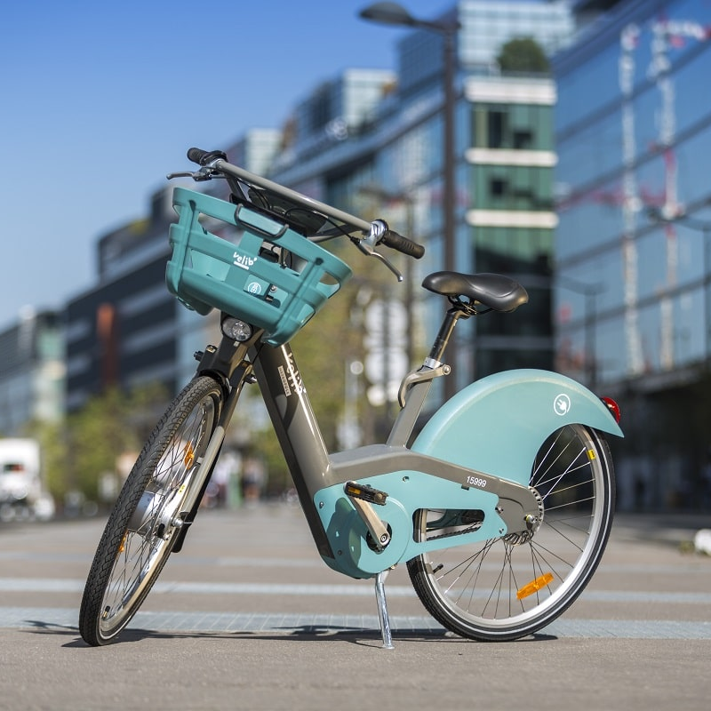
Project Objectives
Significance
Analyze reliability & efficiency of Velib Rental Bikes in Paris.
Investigate factors impacting bike availability.
Address concerns about sustainable transportation.
Enhance service quality for urban commuters.
Contribute to global discourse on eco-friendly mobility.

Slide 3



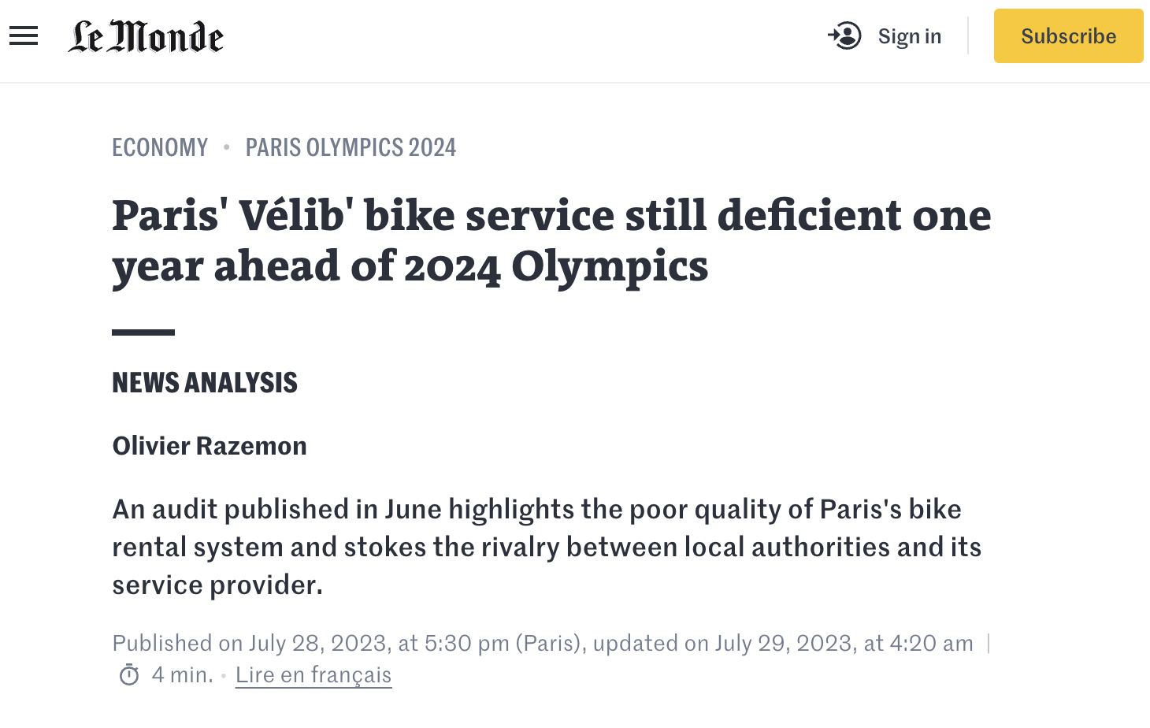



Concerns & Questions:
Parisians report issues with bike availability & docking station functionality.
They are VOCAL!

Slide 4

Hypothesis
Project aims to answer:
Is Velib service efficient enough to meet rental demand?
What factors influence bike availability in Paris?
Null Hypothesis (H0): No significant relationship between given factors and bike availability.

Slide 5
Project Execution Timeline
 | Day 1 | Day 2 | Day 3 | Day 4 | Day 5
Morning | Exploration of Available Data | Variable Formatting & Creation | Grouping & Analysis | Tableau Visualization | Hypothesis Testing
Afternoon | Data Cleaning & Variable Identification | Planning the Analysis & Creating Data Story | Debugging & Formatting Data | Machine Learning Model Development | Presentation

Slide 6
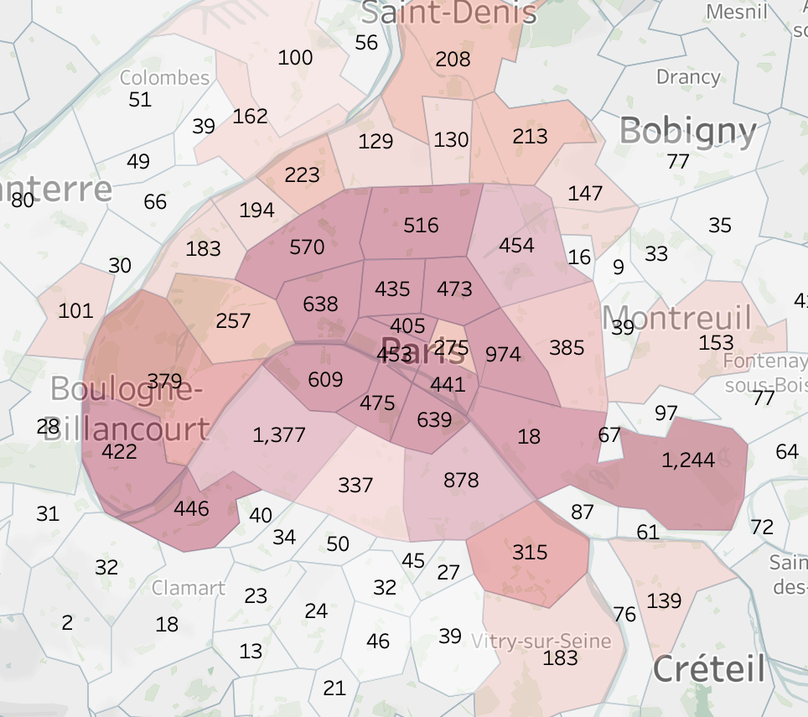
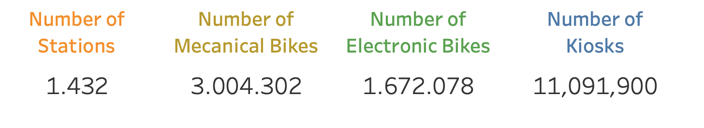
Data Exploration - Unveiling the Velib Landscape
Embarking on our analysis journey, we first explored two key datasets:
Velib availability in real-time: This dataset provides dynamic information on bike and docking station availability across Paris, updated every minute.
Velib station locations: This dataset offers static information on the location, capacity, and other details of each Velib station.

Slide 7
Navigating the Stream: Working with Real-Time Data
Delving into real-time data presented unique challenges:
Diving into real-time: requests module for smooth data handling.
Continuous flow: managing the constant stream of data.
Delays and inconsistencies: issues with data quality
My solutions were
Automated retrieval: implementation of automatic data retrieval, ensuring timely updates.
Daily export: creation of automatic daily exports for consistent analysis.
Adapting techniques: adaptation of data manipulation methods for the real-time nature
Notes:
To efficiently handle the real-time data aspects of this project, I dug up on Python's “requests” module, ensuring the data acquisition and integration. This allowed for effective processing of the continuous data stream.

Slide 8
Data Cleaning & Variable Identification - Refining the Raw Materials
Before diving into analysis, the data required a meticulous cleaning and preparation to ensure its accuracy and relevance.
Shaping the data into a reliable source involved:
Identifying and handling missing values (e.g. duplicates removal from different updates).
Correcting inconsistencies and formatting errors
reformatting boolean variables,
changing dates to datetime format,
retrieving geographic informations from coordinates
Merging and transforming data from 2 different sources

Slide 9

Data Cleaning & Variable Identification - Refining the Raw Materials
Identification of crucial variables influencing bike availability
Time-based information
Availability durations
Update times
Location-based information
Neighborhood
Station location
Capacity
Utilization
Bike Types

Slide 10
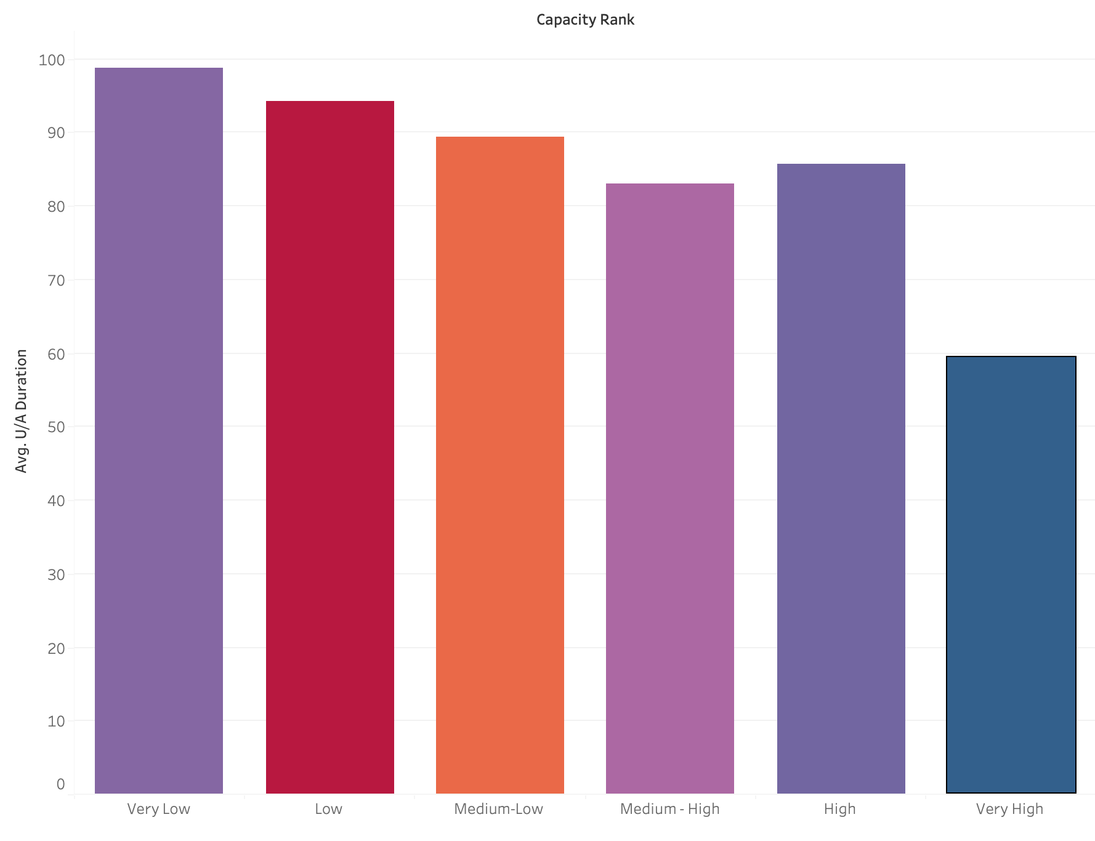
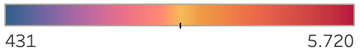
Unveiling the Factors: Unlocking Bike Availability Insights
Capacity Ranking
Capacity ranking vs Average Unavailable Duration of the stations
Sum of capacity in ranks as colors added
AVG Unavailable Durations

Slide 11
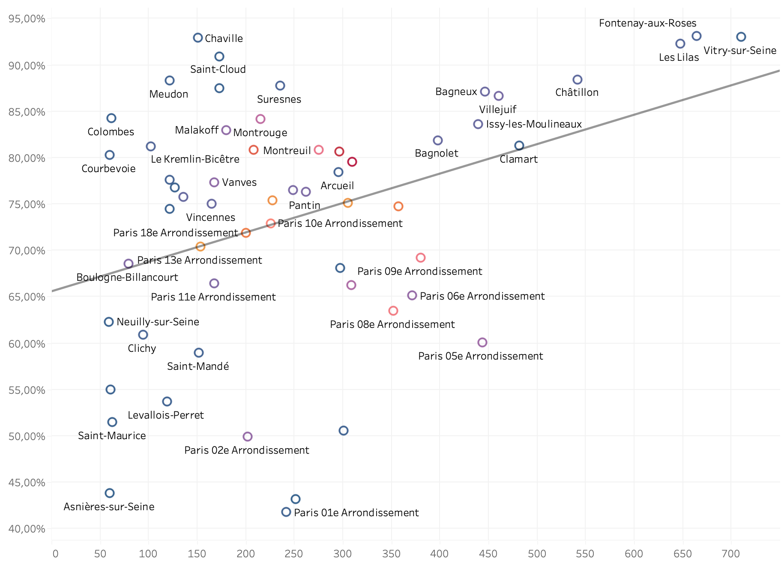
Unveiling the Factors: Unlocking Bike Availability Insights
Total Unavailable Durations per Neighborhood vs Utilization
Sum of capacity of Neighborhoods as colors added

Slide 12
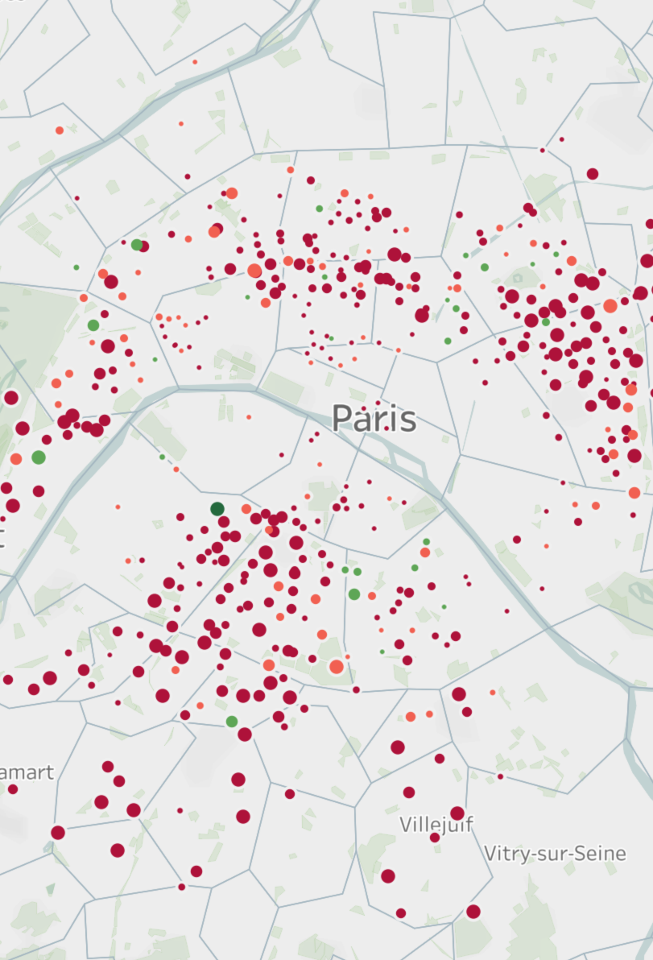
Unveiling the Factors: Unlocking Bike Availability Insights
Utilization rate shown as size
Unavailable duration by minutes shown as colors
Dashboard link

Slide 13
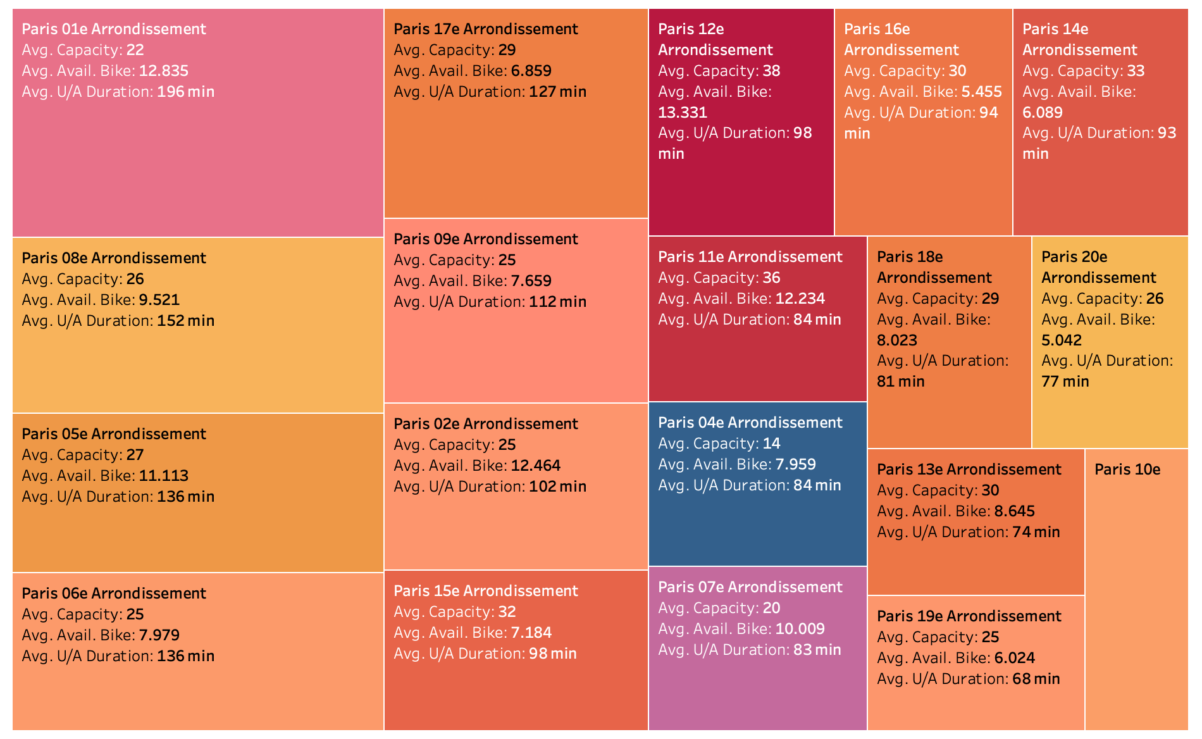
Paris Deep Dive
Paris dominance amongst banlieues was apparent so I added a Paris Deep Dive

Slide 14

Predicting the Future: Leveraging Machine Learning for Bike Availability
Beyond analysis, I aimed for prediction by developing a machine learning model to forecast bike unavailability.
Data Preparation:
Selecting relevant features based on their potential impact on bike availability.
Applying MinMax scaling to numerical features to ensure they are on a consistent scale.
Using One-Hot encoding for categorical features to represent them as binary vectors suitable for the model.
During Data Preparation I realized there was a problem with the data where the capacity of a station in certain cases was higher than the available bikes in the station. Once I investigate the issue, I realized that Velib recently put on a service called Station+

Slide 15
Model Selection and Training
Since my data has limited features, I needed to try my best to find a good model to fit.
Tested Regression Models:
Linear Regression,
KNeighborsRegressor
Random Forest Regressor
(ensemble method combining multiple decision trees)
Gradient Boosting Regressor
(ensemble method sequentially building regression models)
MLPRegressor
(type of neural network for examining complex non-linear relationships)
DecisionTreeRegressor
Linear Regression as Optimal Choice
Selected based on superior performance and alignment with our specific needs shown as following metrics:
Mean Absolute Error (MAE) measures the average absolute difference between predicted and actual bike availability. This choice focused on minimizing the absolute error, regardless of direction, to ensure reliable predictions in both high and low availability scenarios.
R-squared and Adjusted R-squared offer insight into the overall goodness-of-fit of our model as well as complementing MAE in evaluating predictive accuracy and reliability.
Using Linear Regression also allows optimizing these metrics effectively, ensuring accurate predictions and reliable insights into bike availability.

Slide 16
Hypothesis Testing
Communes and Unavailable Duration: (Result: Reject H0)
There is a significant relationship between communes and unavailable duration.
F one-way analysis
Capacity and Unavailable Duration: (Result: Reject H0)
There is a significant relationship between capacity and unavailable duration.
Correlation analysis (P = 0.19)
Availability of Bikes and Unavailable Duration: (Result: Reject H0)
There is a significant relationship between the availability of bikes and unavailable duration.
Correlation analysis used (P = 0,34)
Unavailable Count and Unavailable Duration: (Result: Reject H0)
There is a significant relationship between the unavailable count and unavailable duration.
Correlation analysis used (P=0,58)

